Slide 1
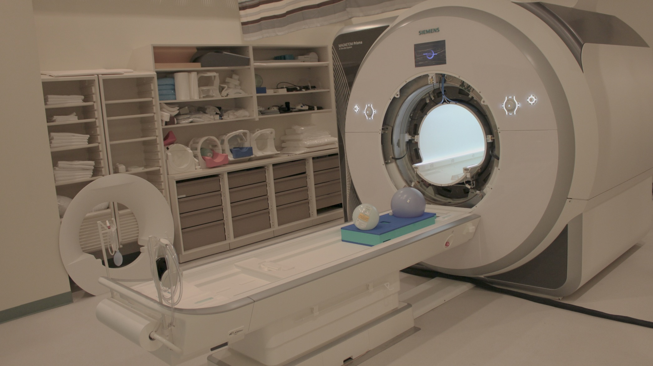
PowerGrid for harnessing high performance computing to reconstruct large sets of high-resolution non-Cartesian MRI data
Brad Sutton
Assoc Prof, Bioengineering Department
Technical Director, Biomedical Imaging Center
Beckman Institute for Advanced Science and Technology
University of Illinois at Urbana-Champaign

Slide 2
Need for Image Reconstruction Packages in MRI
Most fMRI and DTI acquisitions for functional and structural connectivity are acquired by single-shot EPI (SS-EPI)
This is limited and suboptimal as data goes to higher resolutions
SS-EPI has echo time in the center of the readout- extra echo time and extra decay.
Increased delay with increased spatial resolution. Not so with spiral
Spatial resolution for single-shot data is limited by T2* blur and field inhomogeneity
Modern acquisitions have fully 3D trajectories with undersampling in all three dimensions
Unfortunately, raw data sizes large and recons are computationally expensive – must save raw data to enable future recon tools

Slide 3
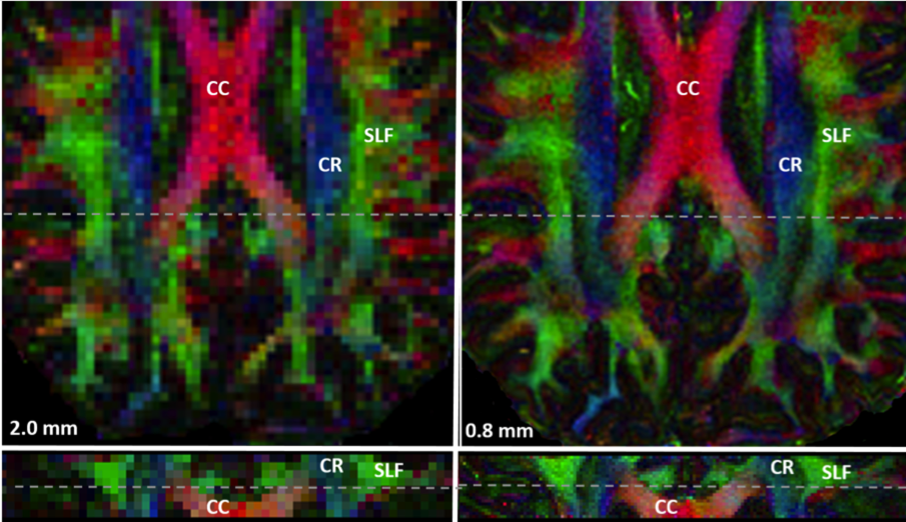
Enabling Improved delineation of fiber pathways
3D multi-shot, multi-slab navigated spiral DTI
SNR efficient
Correction for:
Motion induced phase
Magnetic field inhomogeneity
Undersampled data
Holtrop and Sutton, J Med Imaging, 2016.

Slide 4
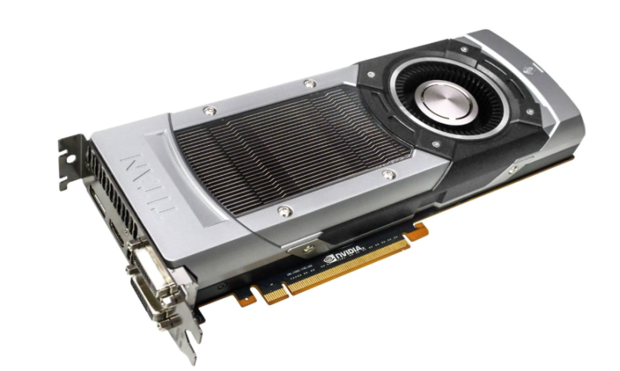
Challenge: Image Reconstruction
Large matrix size
1.25 mm isotropic data set
Data Size:
18 GB for 6.5 min scan
Physics:
3D non-Cartesian (Spiral) sampling
Parallel Imaging with 32 channel coil
Magnetic Field Inhomogeneity Correction
Motion-induced Phase Correction
Reconstruction Time
8 days for reconstruction running on workstation
Graphics Processing Units (GPU)
100’s times faster: <1 hour.
Enables imaging resolutions not feasible before.
GTX TITAN GPU: ~$700 (6GB)
CORES: 2688
Base Clock: 876 MHz
IMPATIENT MRI: Illinois Massively Parallel Acceleration Toolkit for Image reconstruction with ENhanced Throughput in MRI
PowerGrid –ISMRM 2016.

Slide 5
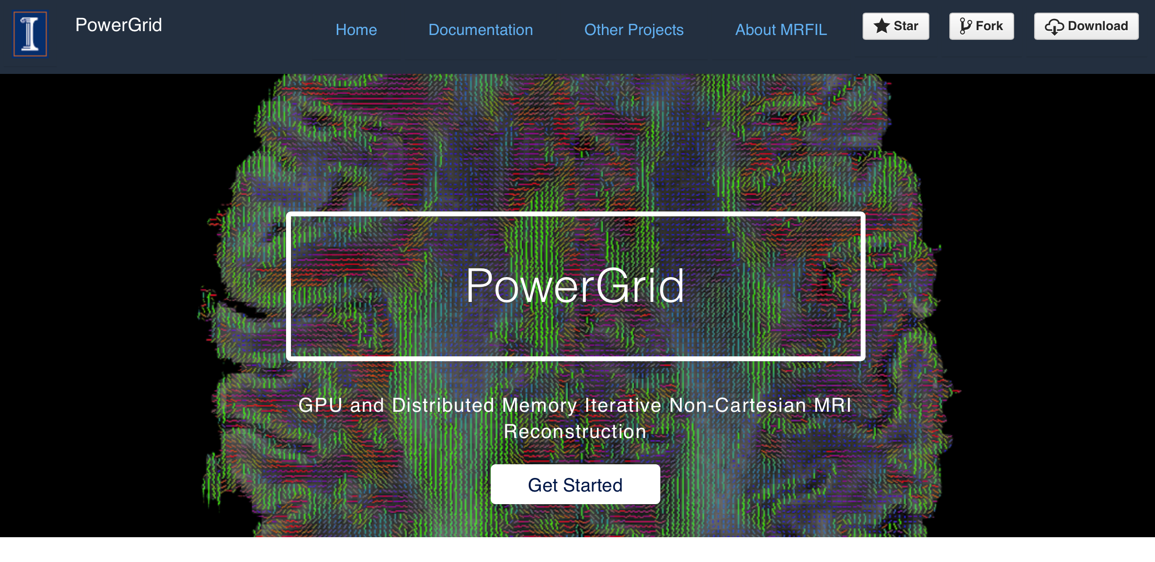
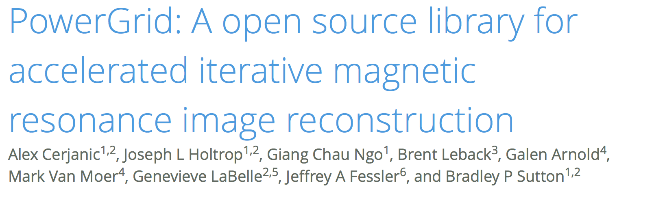
http://mrfil.github.io/PowerGrid/
ISMRM 2016, p. 525

Slide 6
Flexible, Readable, and Modifiable
IRT/MATLAB SENSE Operator
PowerGrid/C++ SENSE Operator
%Forward Operator
outData = zeros(nx,ncoils);
for ii = 1:ncoils
outData(:,ii) = G*(SMap(:,ii).*d(:));
end
%G*d is a forward NUFFT/DFT
//Forward Operator
Col<CxT1> operator*(const Col<CxT1>& d) const {
Mat<CxT1> outData = zeros<Mat<CxT1>>(nx,ncoils);
for (int ii = 0; ii<ncoils; ii++)
outData.col(ii) = (*G_obj)*(SMap.col(ii)%d);
return vectorise(outData);
//G_obj*d is a forward NUFFT/DFT
}
Structure of forward and adjoint transforms is maintained
Code is easily portable from MATLAB to PowerGrid/C++ via Armadillo

Slide 7
PowerGrid: Enabling use of GPU/HPC
Goal: Scalable across desktop to supercomputer
Desktops, GPUs, Clusters, and even Supercomputers
via OpenACC and MPI

Slide 8
Scale: Distributed Memory Computing
How to use > 1 GPU?
Message Passing Interface (MPI)
Phase Corrected SENSE (pcSENSE) for Diffusion Imaging
120 x 120 x 4 x 32 coils
16 GPU: 51s
Liu C, Moseley ME, Bammer R. Simultaneous phase correction and SENSE reconstruction for navigated multi-shot DWI with non-cartesian k-space sampling. MRM. 2005;54(6):1412–1422.
K20x: 2688 cores, 732 MHz clock rate. 6 GB.

Slide 9
Conclusion
Need raw data reconstruction resources to accommodate next generation acquisitions
Also need ways to store and share raw data
Computationally intensive: need to bring resources to MRI physicists
Enable order of magnitude improvements in spatial and temporal resolutions
Thanks:
MRFIL Lab: Alex Cerjanic, Joe Holtrop, Giang-Chau Ngo, Genevieve Labelle
Jeff Fessler, B. Leback, G. Arnold, M. Van Moer
PGI, NVIDIA, BlueWaters, Parallel Computing Institute
NIH R01EB018107, Blue Waters Illinois Allocation
National Science Foundation (awards OCI-0725070 and ACI-1238993)

